Slide 1
LTEL Designee Training
LAUSD
Master Plan for English Learners
ESC West
10/10/14

Slide 2

Objectives
To receive an overview of the agreement made with LAUSD and the Office for Civil Rights
To define Long Term English Learners
To understand the roles and responsibilities of the LTEL Designee
To understand how to use the district’s monitoring tools and resources

Slide 3
Warm Up: “Like Me”
Stand up if…
  You are an EL Designee
  You are an administrator
  You are a Title III Coach
  You are a counselor
  You are a classroom teacher
  You are another out of classroom support staff (Coach, coordinator, specialist, etc.)
  You have taught English Learners
  You learned English as a second language
  You learned a second language
  You make a difference in the lives of students

Slide 4
Professional Reading
Reparable Harm –”Executive Summary”
Text as Evidence Activity:
  Read pages 1-4, the Executive Summary
  Fill in the “Say, Mean, Matter” chart:
    Pick 2-4 salient quotes or something that speaks to you, include the page numbers
    What does it mean to you?
    Why does it matter?
  Be prepared to share out
Say (Copy a passage from the text that helps to answer the focus question) | Page/ Paragraph # | Mean (Explain in your own words what the passage means) | Matter (Explain why you believe this passage is important. )
1. |  | This means… | This is important because…
2.

Slide 5
Share out: “Say, Mean, Matter”
Say (Copy a passage from the text that helps to answer the focus question) | Page/ Paragraph # | Mean (Explain in your own words what the passage means) | Matter (Explain why you believe this passage is important. )
1. |  | This means… | This is important because…
2.
Additional Resources:
Participatory Leadership for English Learner Success
Changing Course for Long Term English Learners

Slide 6

LAUSD’s definition of LTELs
Long Term English Learners (LTEL)
Master Plan p. 65: “defined in LAUSD as those EL students who have completed five full years in U.S. schools (i.e. beginning their sixth year and beyond) without meeting the criteria for reclassification.”

Slide 7

LTELs in Ed. Code
Ed. Code 313.2 (LTELs)
(a) The department shall annually ascertain the number of pupils in each school district and school, including a school that is within the jurisdiction of a county office of education and a charter school, who are, or are at risk of becoming, long-term English learners…
  CDE defines LTELs as having been an English Learner for more than six years.

Slide 8
LTELs with IEPs
LTEL students with disabilities who have an IEP need to have their progress monitored on a consistent and timely basis
The IEP Team will monitoring the LTEL students’ progress
The LTEL Student Goal Sheet will not be considered necessary documentation for any LTEL who currently has an IEP
The IEP case manager may consult with the LTEL Designee
Note: Because students with 504 plans do not have IEPs, LTEL Designee will monitor LTEL students with 504 plans.

Slide 9
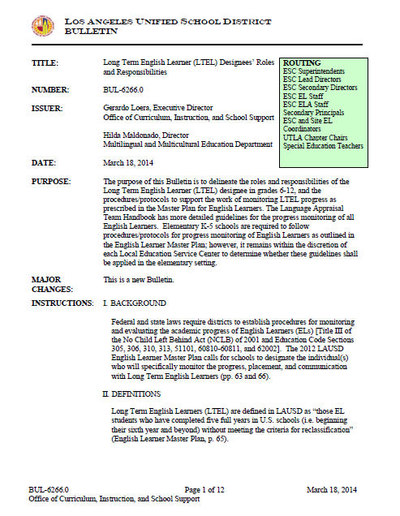
BUL-6266.0 LTEL Policy

Slide 10
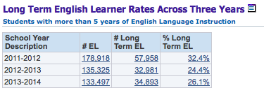
LAUSD Data

Slide 11
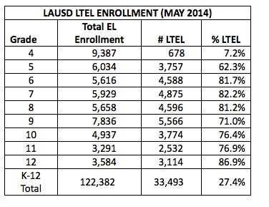
LTEL Data
What does the data tell you?
Share Out

Slide 12
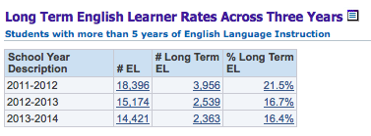
ESC West Data

Slide 13

Table Talk
How many LTELs are at your site?
What patterns do you see?
How has your school addressed some these issues?
Notes:
Be aware of accepting approximation of numbers based on MiSiS concerns.

Slide 14

Master Plan
Part of the U.S. Department of Education’s Office for Civil Rights agreement (October 2011)
Board Approved in June 2012
Stakeholder groups involved:
  AALA, UTLA, Parents, Experts, Consultants

Slide 15
Master Plan
Page 63 (Middle Schools)
Page 66 (High Schools)
“All middle school LTELs are designated a specific counselor, teacher specialist or faculty member to monitor their language status, test, goals for meeting grade level standards and reclassification. All LTELs and their parents meet at least twice yearly with the designated faculty member to review current language status, program placement, test results and goals for attaining reclassification criteria and accelerated academic progress targets.”
“All LTELs in grades 9-12 are designated a counselor, teacher specialist or faculty member to monitor their language status, test, goals for meeting grade level standards and reclassification. All LTEL students and their parents meet at least twice yearly with this designated faculty member to review current language status, program placement, test results and goals for attaining reclassification criteria and accelerated academic progress targets.”

Slide 16
ESC West
ESC West:
All elementary school LTELs are designated a specific teacher or faculty member to monitor their language status, test, goals for meeting grade level standards and reclassification. All LTELs and their parents meet at least twice yearly with the designated faculty member to review current language status, program placement, test results and goals for attaining reclassification criteria and accelerated academic progress targets.

Slide 17


Performance Meter

Slide 18
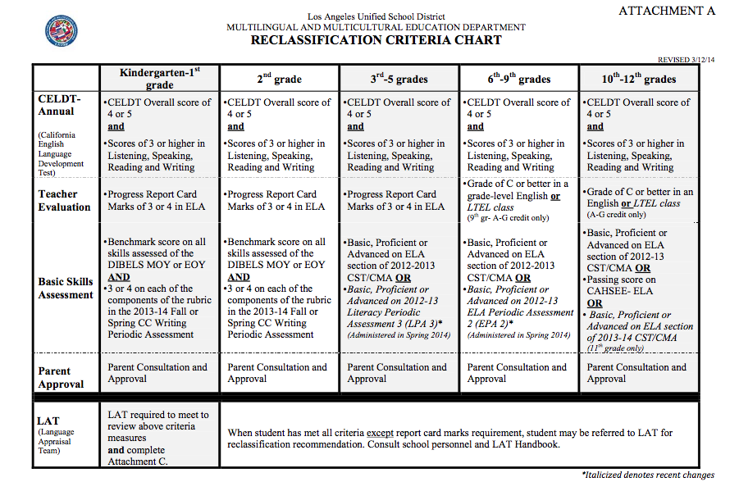
Reclassification of Eligible Students
(LPA/Basic Skills Assessment Results)
BUL-5619.2

Slide 19
*Basic English Skills Assessment for Reclassification for 2014-2015
CST/LPA/PA scores were only banked for one year
  Cannot be used for reclassification purposes for 2014-15
Reclassification options:
  Schools cannot reclassify students first semester
  K-1 is still staying the same (DIBELS)
  2nd grade will stay as is (DIBELS)
  3rd-5th grades- teachers will administer DIBELS (DORF and Daze) for their grade level
    Students need to score at Benchmark to meet the reclassification criteria
    There might be a writing component
6th-9th grades- The District is considering SRI (Scholastic Reading Inventory).
10th-12th grades- CAHSEE
*Not written into policy at this time

Slide 20

LTEL Designee Roles & Responsibilities
Monitors each LTEL’s:
  Language status
  Test results
  Goals for meeting grade level standards
  Progress towards reclassification
Meet with students and parents twice a year to review:
  Language status
  Program placement
  Test results
  Goals for attaining reclassification criteria and accelerate academic progress targets
LTEL Designee will be a standing member of the Language Appraisal Team (LAT)
Maintain documentation of the individual conferences and meetings
Notes:
Notes for Presenter:
Language status = language classification (LEP) for five years or more, English Learners (EL), Long Term English Learners (LTEL)
Test results = CELDT, CST, CMA, LPA, CAHSEE
Goals for meeting grade level standards/academic progress targets = grading, portfolios, benchmarks (proficiency rates, minimum progress expectations, etc.)
Progress toward reclassification = reclassification criteria
Program Placement = Structured English Immersion (EI), SI (Special Ed. SEI), Mainstream, Dual Language (DL), Waiver to Basic (WB), P/PRP (Preparing to Reclassify), Sheltered (SH)

Slide 21
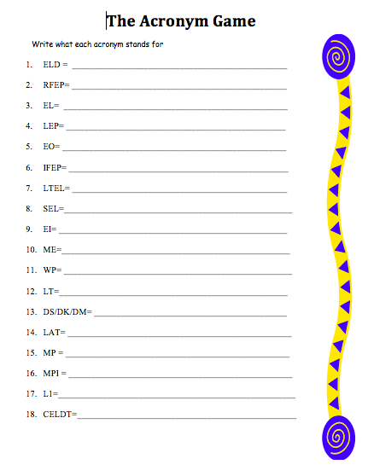
Activating Prior Knowledge:
Acronym Game
Individually, you have one minute to complete the “Acronym Game”
Now, you have 3 minutes to find someone, not at your table, to help you complete the sheet
Notes:
Follow up question:
How did it feel to work individually?
How was it different to work with a partner?
Review answers.

Slide 22

Tools for Monitoring
LTEL Data

Slide 23
My Integrated
Student Information System (MiSiS)
Language status, test results, program placement

Slide 24
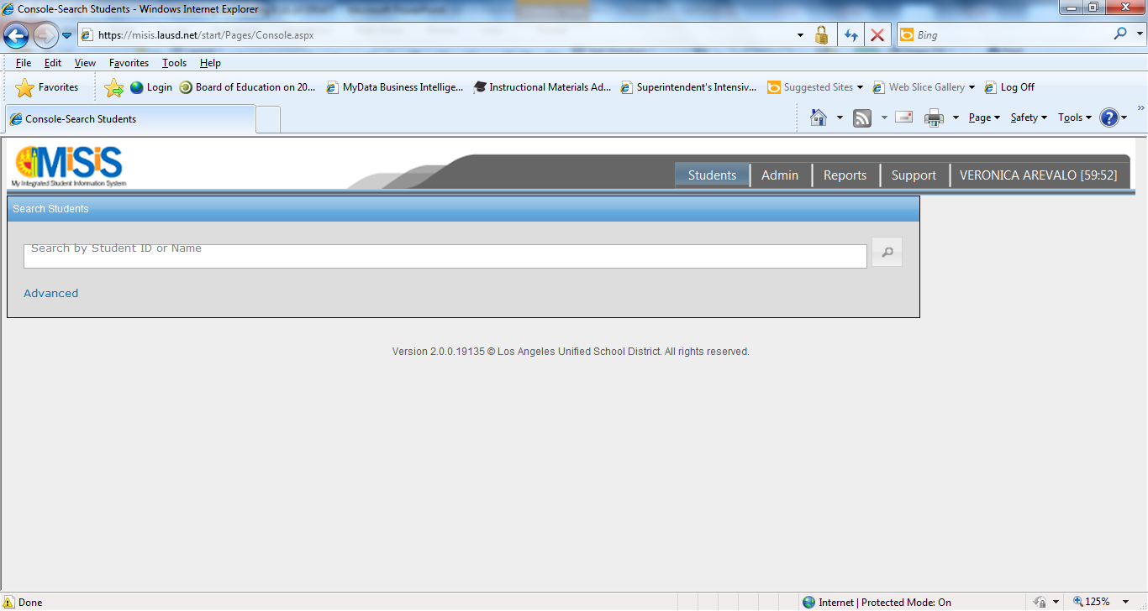
MiSiS: EL Rosters
Reports

Slide 25
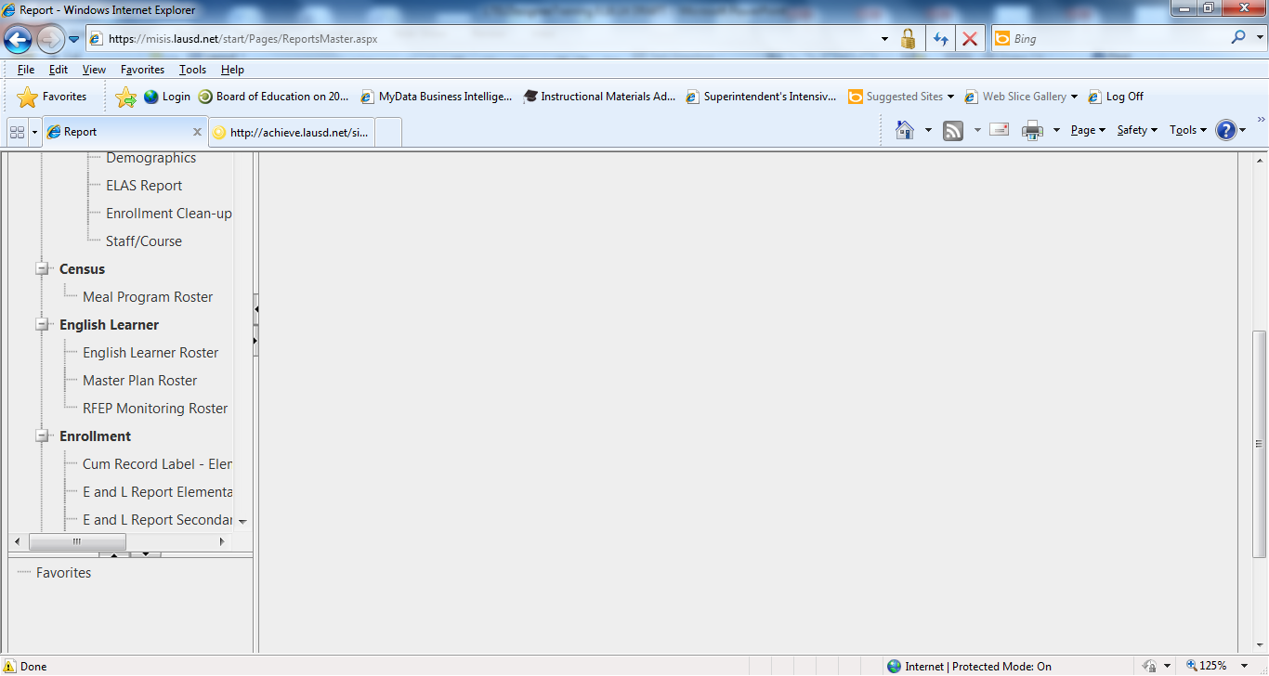
MiSiS: Master Plan Roster
English Learner:
EL Roster
Master Plan Roster

Slide 26
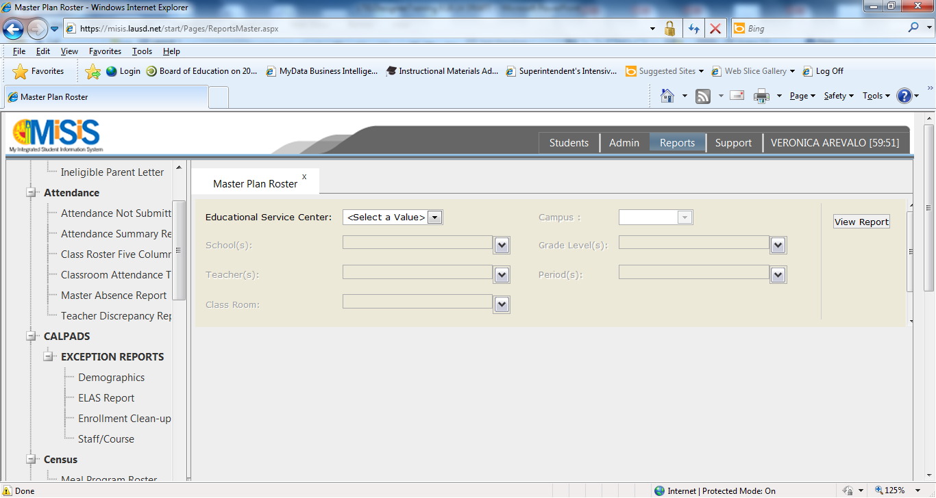
MiSiS: EL Rosters
Select values

Slide 27
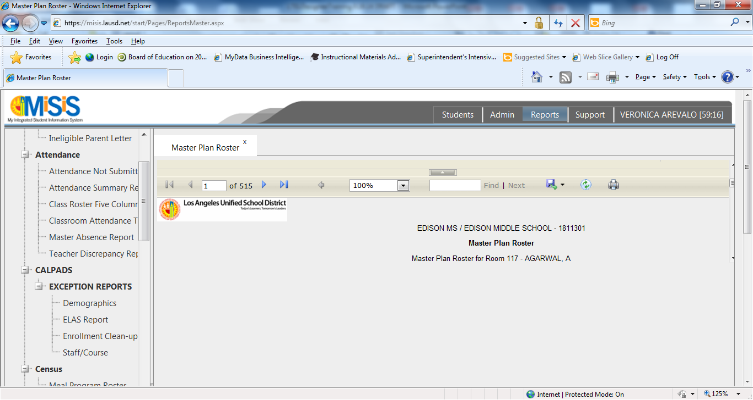
MiSiS: EL Rosters
Click on save icon
If you don’t see the save icon, click on the inside scroll bar, scroll down.

Slide 28
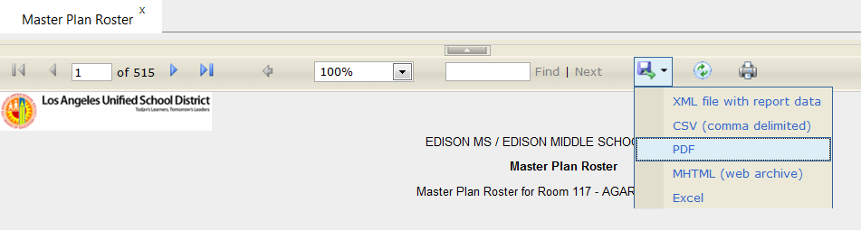
MiSiS: EL Rosters
Save as a PDF

Slide 29
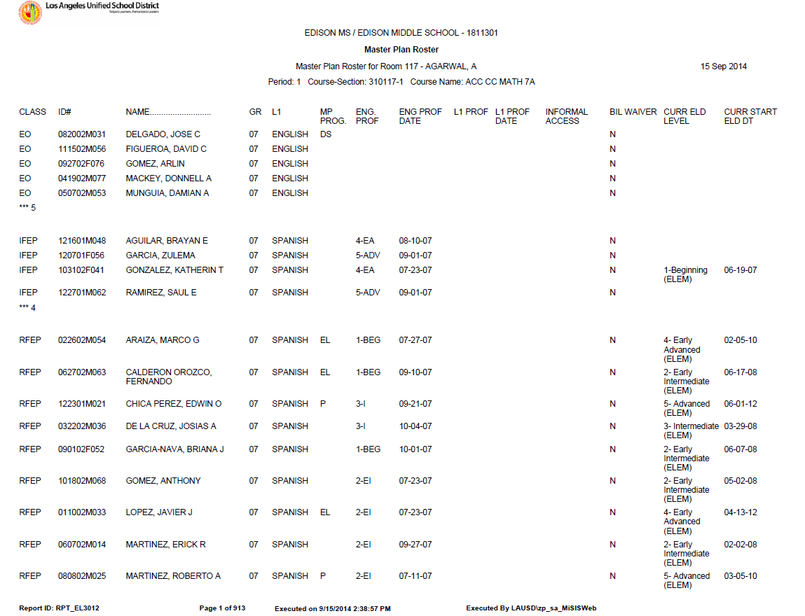
Master Plan Roster

Slide 30
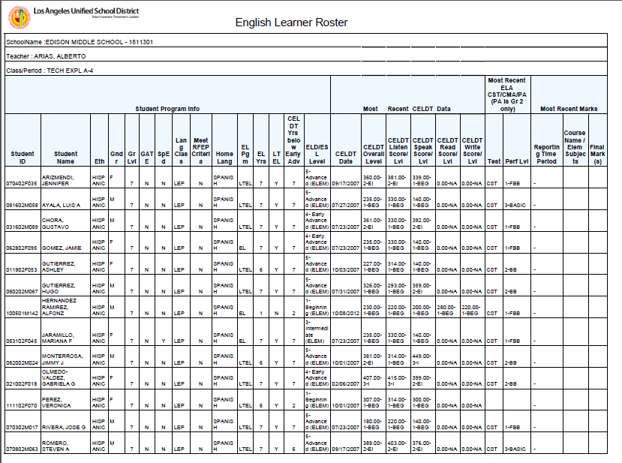
English Learner Roster

Slide 31
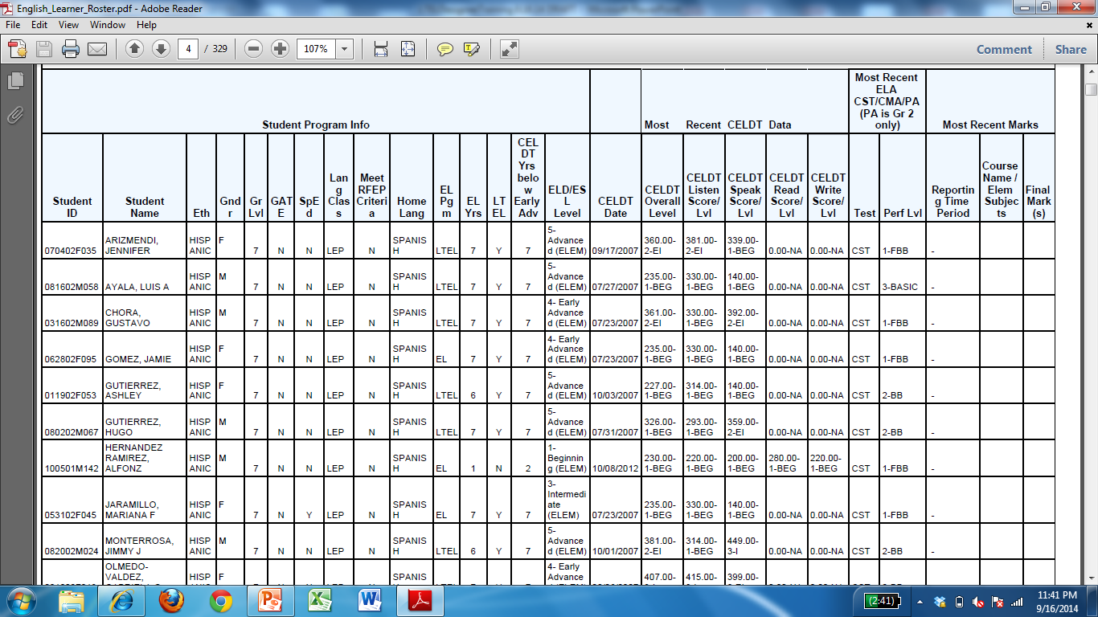
EL Roster

Slide 32
EL Roster

Slide 33
Guided Practice
Look at your sample EL Roster
Which students would you highlight? Why?
Discuss with an elbow partner.

Slide 34
MyData
Accessing language status, test results, program placement, progress toward reclassification

Slide 35
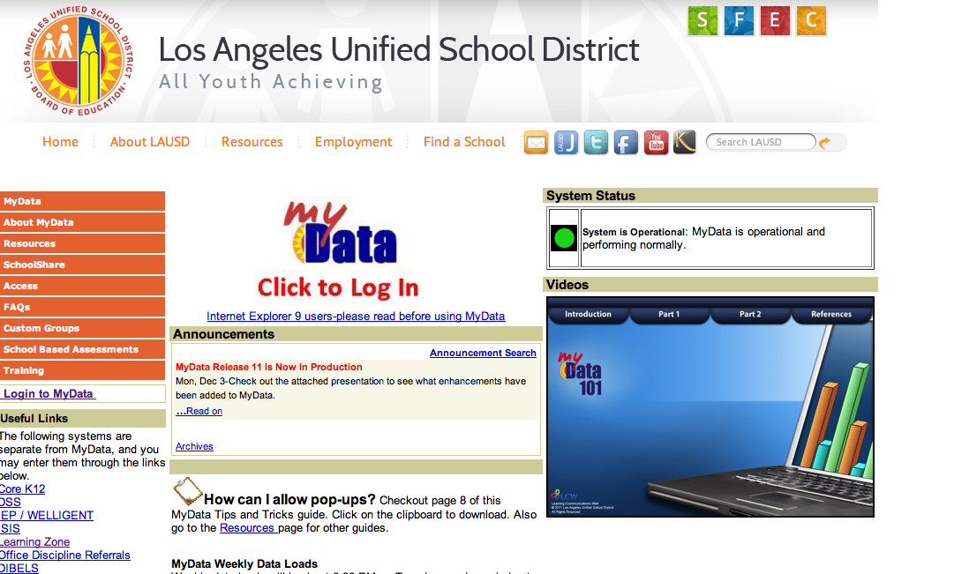
mydata.lausd.net
Click Here

Slide 36
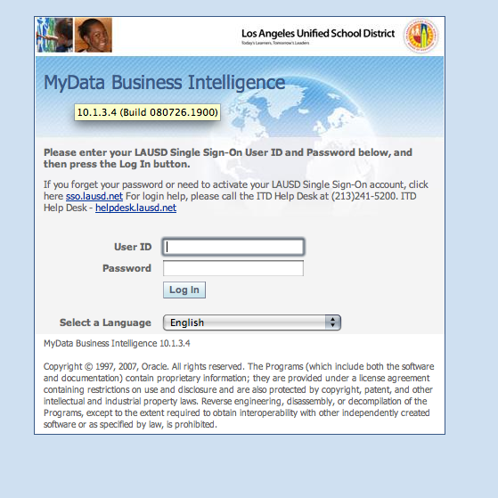
Log In

Slide 37
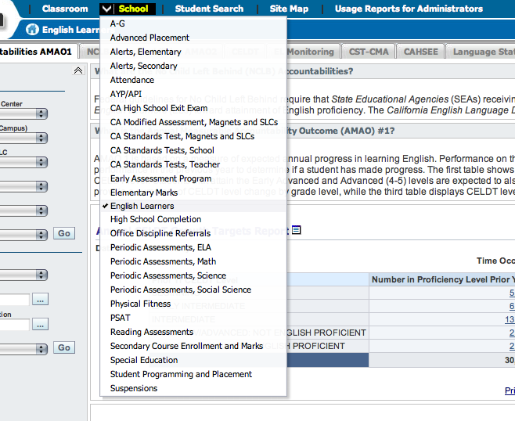
Click Here
Click Here
Click Here

Slide 38
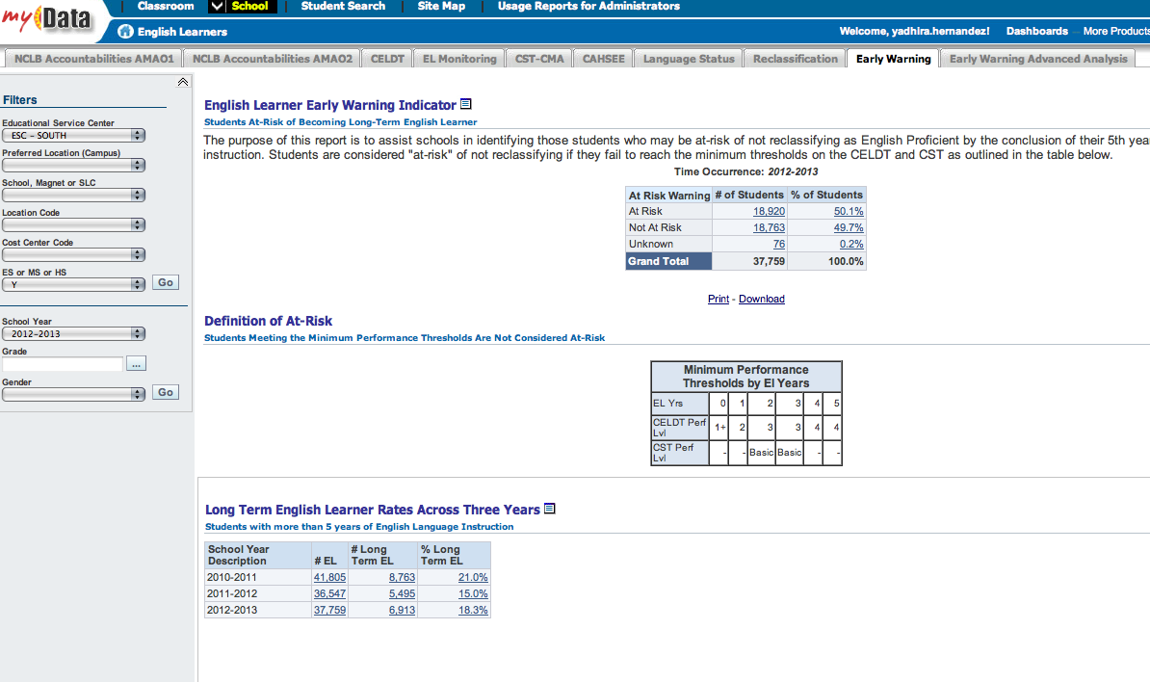
Click Here
LTEL numbers

Slide 39
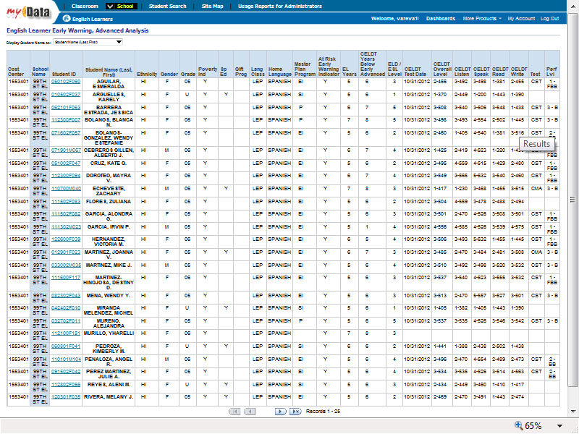

Slide 40
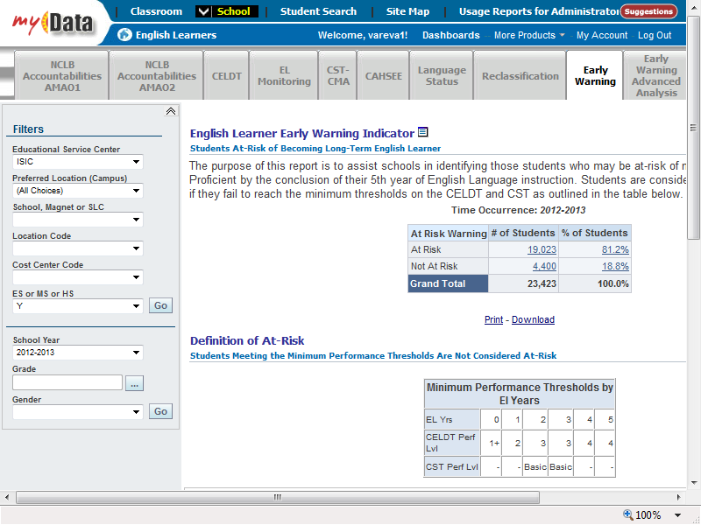
EL Monitoring

Slide 41
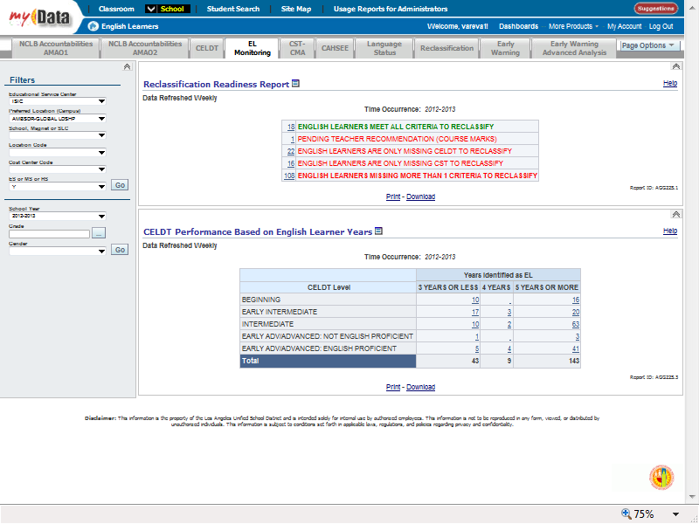
Progress towards meeting reclassification criteria

Slide 42
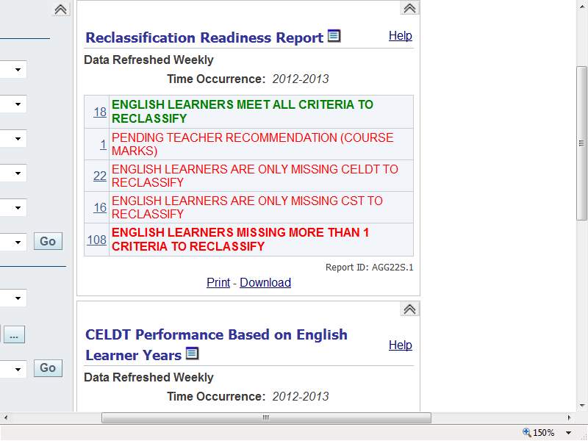

Slide 43
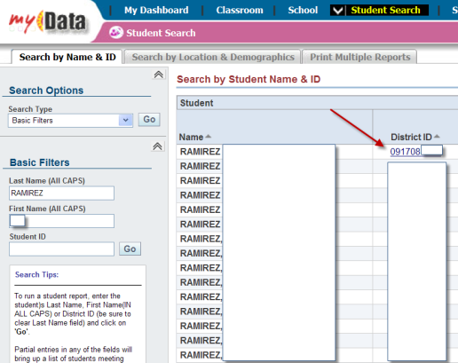
Accessing ELD Progress Profile

Slide 44
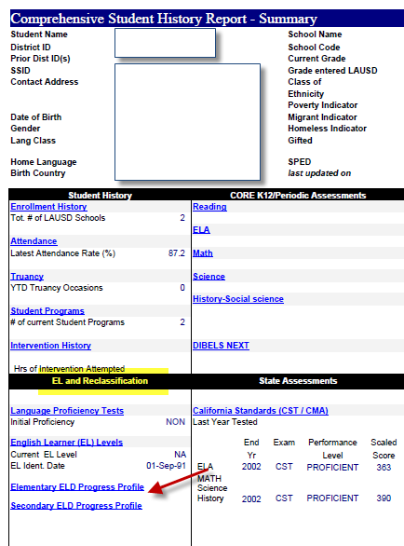
Accessing ELD Progress Profile

Slide 45
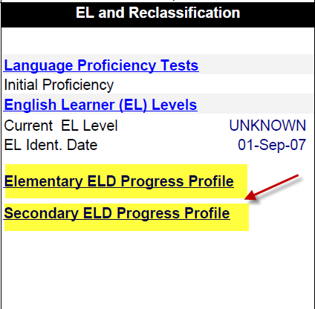
Accessing ELD Progress Profile

Slide 46
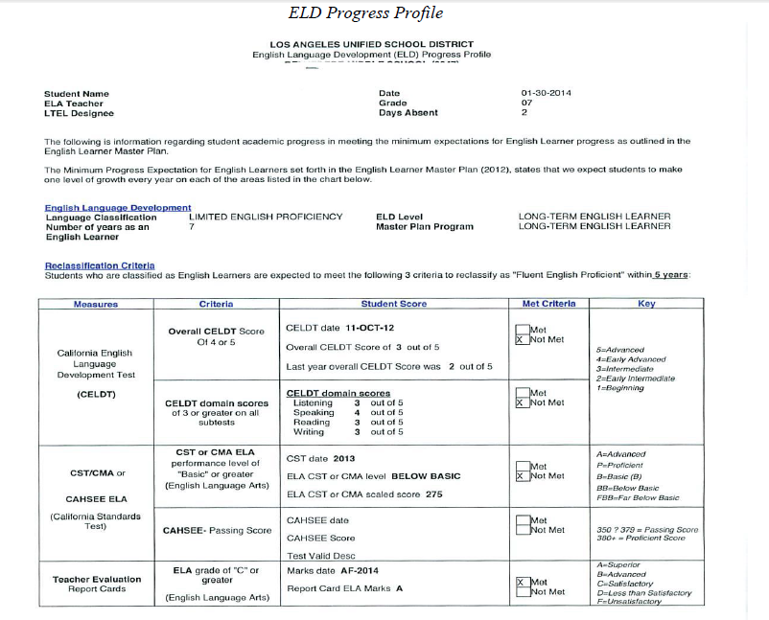
ELD Progress Profile

Slide 47
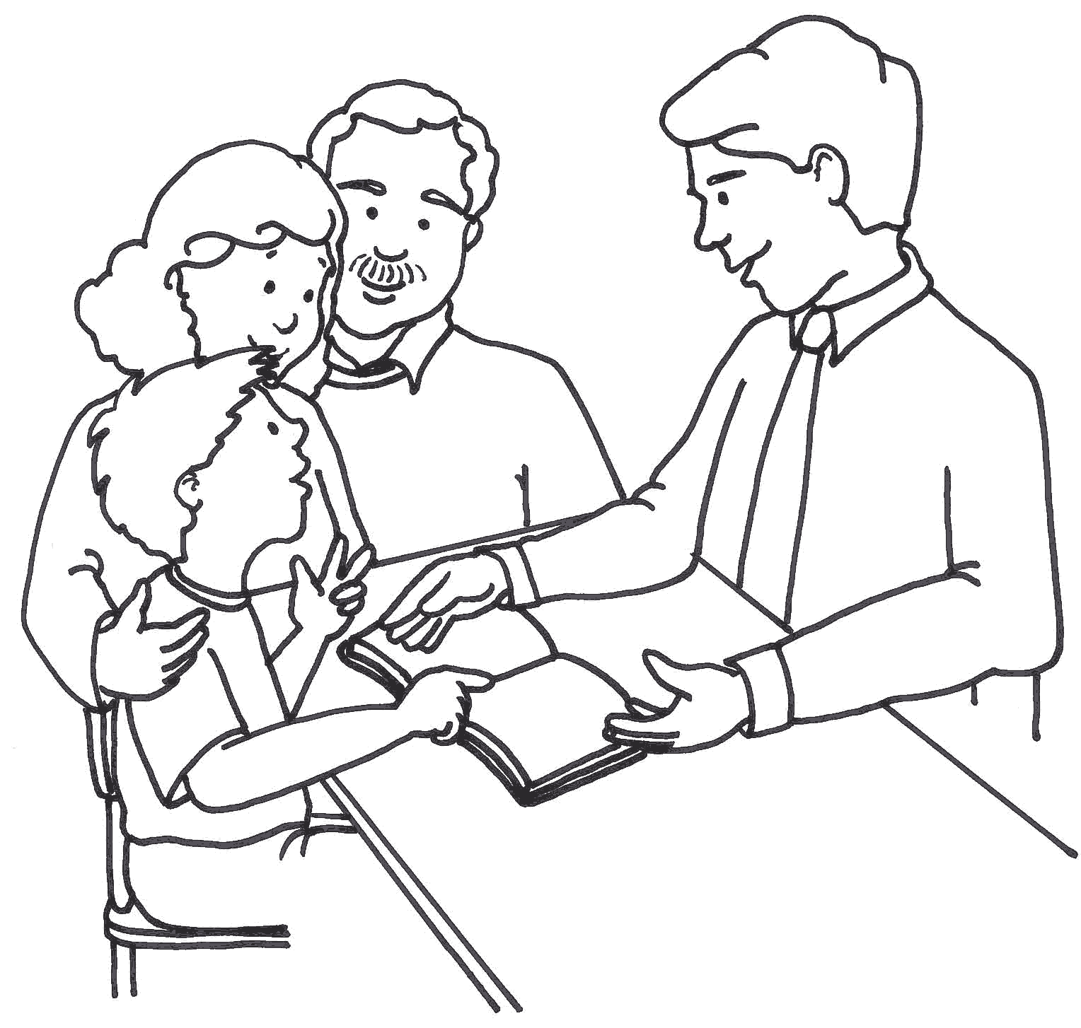
LTEL Student-Parent Conference

Slide 48
Preparing for the parent/student conference
Meet with students and parents twice a year to review:
  Language status
  Program placement
  Test results
  Goals for attaining reclassification criteria and accelerate academic progress targets

Slide 49

Conference Practice
What information would you pull from the EL Progress Profile to share with students and parents?
What would you say?
Practice with a partner
Share out

Slide 50
It’s Your Turn
Use My Data and/or MiSiS to pull LTEL information for your school site.
How many LTELs are at your school?
Who are they?
What patterns do you see?
What are your next steps?

Slide 51

Goals for Meeting
Grade Level Standards

Slide 52

Goals for Meeting Grade Level Standards
As measured by
  Semester/Trimester Grades
  Midterm progress reports
  CST/CMA/CAHSEE scores
  DIBELS, PA scores

Slide 53
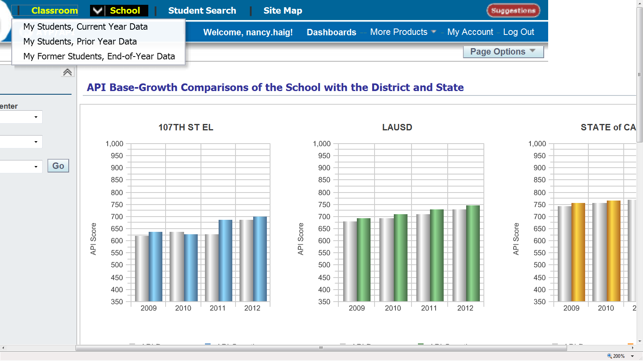
Classroom Tab
My Students, Current Year Data

Slide 54
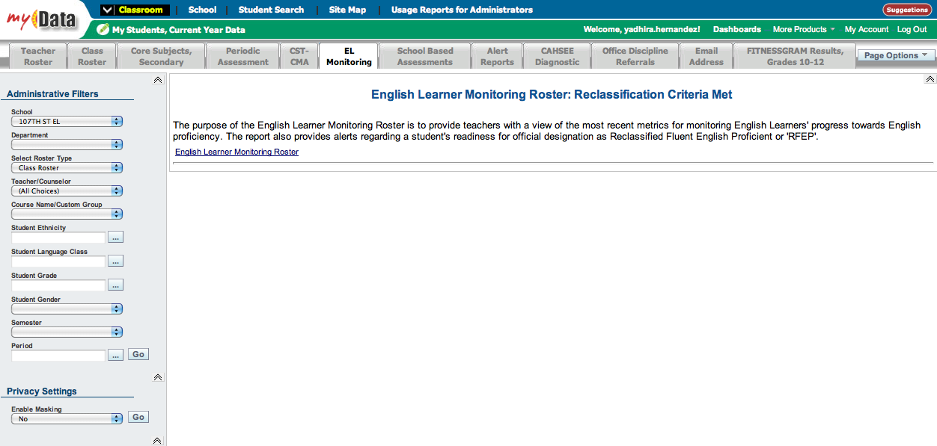
1. EL Monitoring Roster
2. Teacher: All Choices
3. Click Go

Slide 55
EL Monitoring Roster

Slide 56
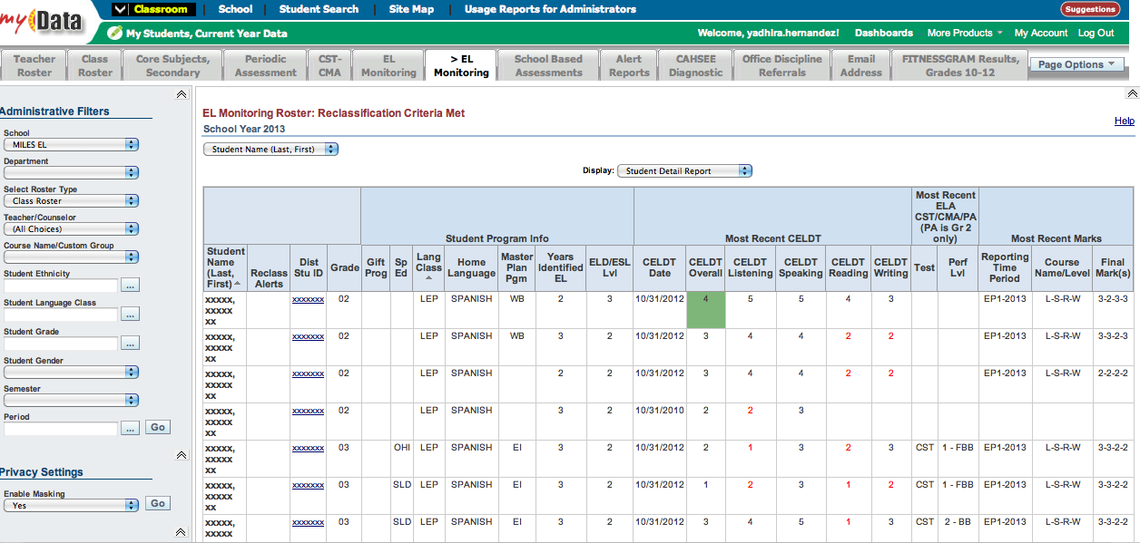
Click Header to Sort Language Classification for LEP

Slide 57
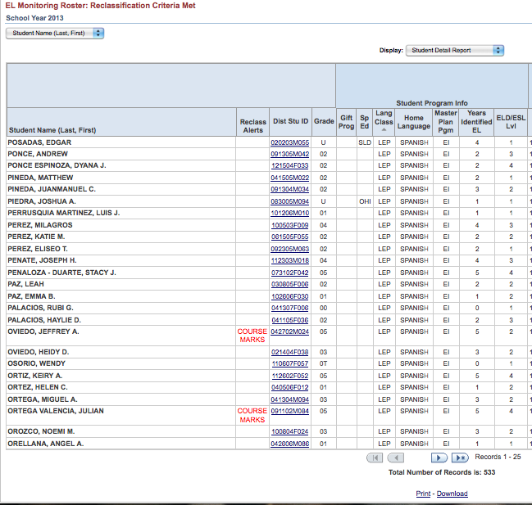
Download to Excel

Slide 58
Elementary My Data Screens
ELA Grades, test scores

Slide 59
Additional Monitoring Screens on MyData
Elementary – English Language Arts
Classroom Tab
My Students, Current Year Data

Slide 60
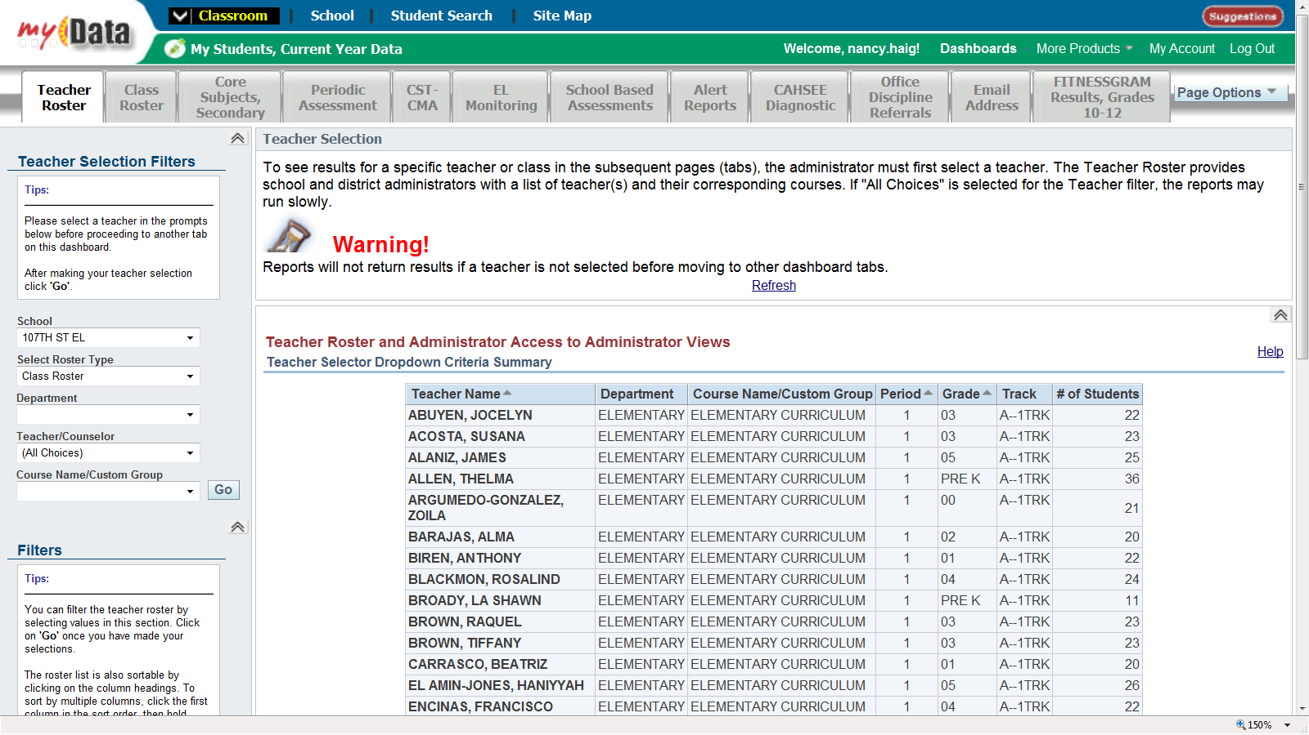
Teacher (All Choices)

Slide 61
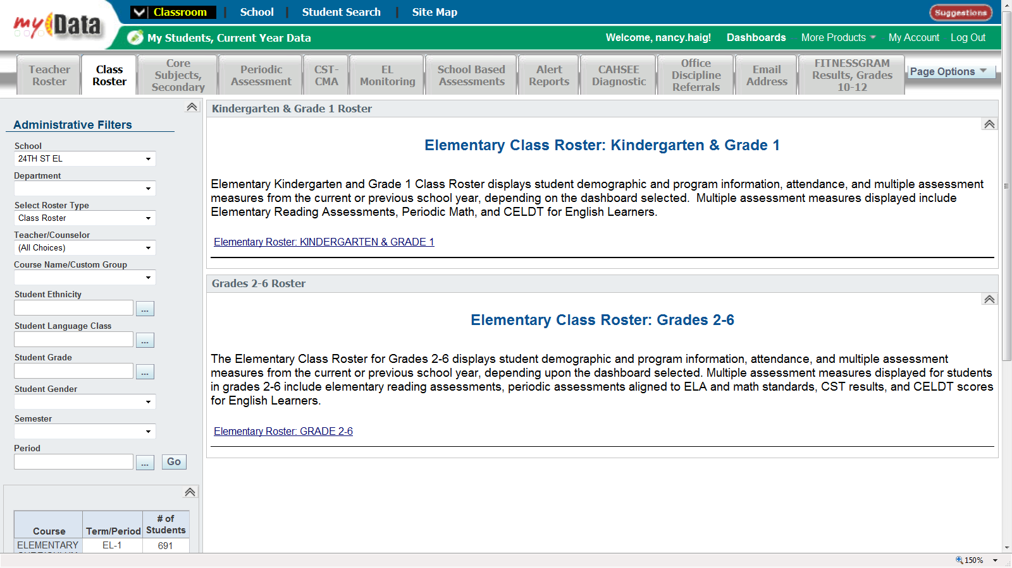
Class Roster
Elem. Class Roster
Grades 2-6

Slide 62
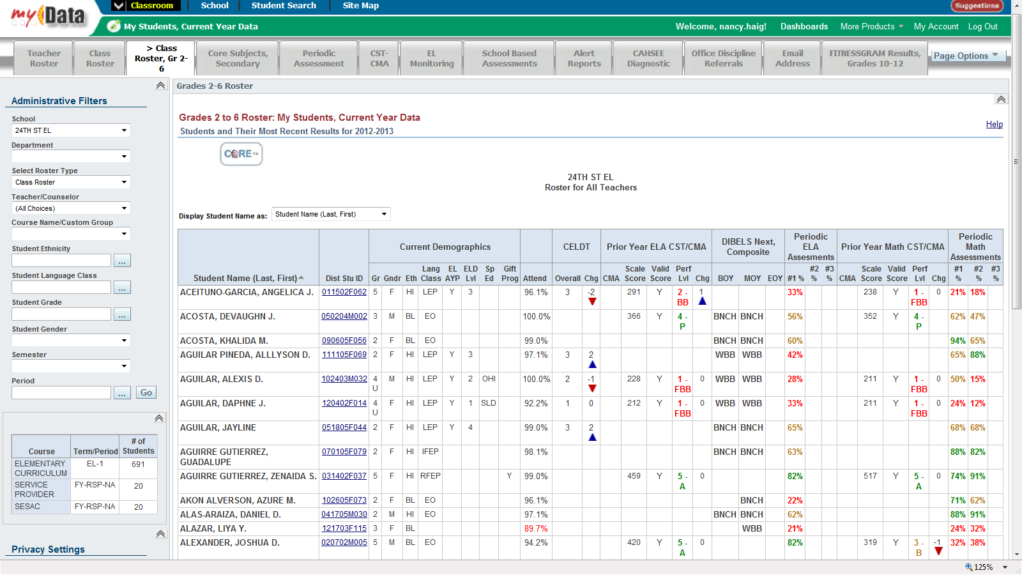
Elementary – English Language Arts
Data: Current Demographics, Attendance, CELDT,
Prior Year CST/CMA, DIBELS, Periodic ELA Assessments

Slide 63
Secondary MyData Screens
English/ELD Grades, test results

Slide 64
Additional Monitoring Screens on myData
Secondary– Core Subject English Language Arts
Classroom Tab
My Students, Current Year Data

Slide 65
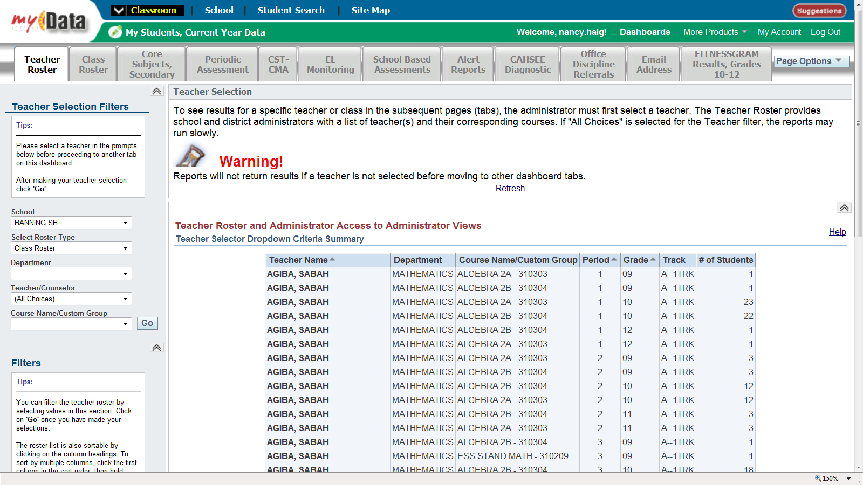
Teacher: (All Choices)

Slide 66
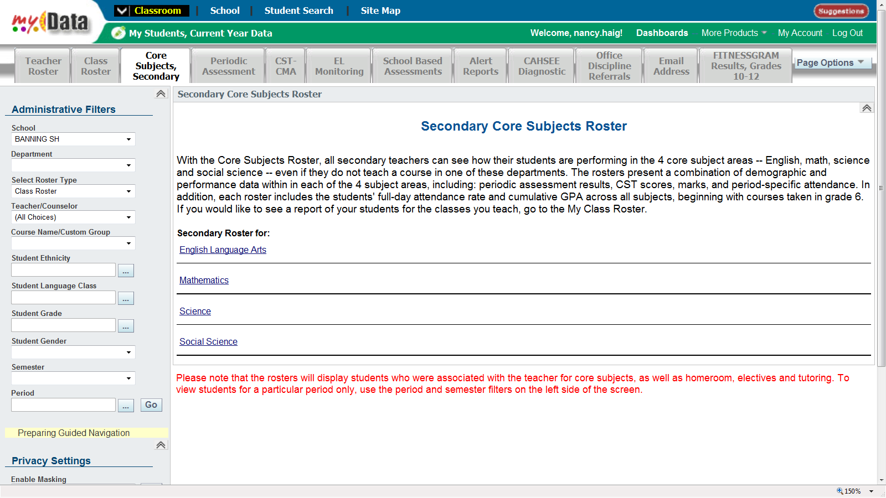
Core Subjects
Secondary
English Language Arts

Slide 67
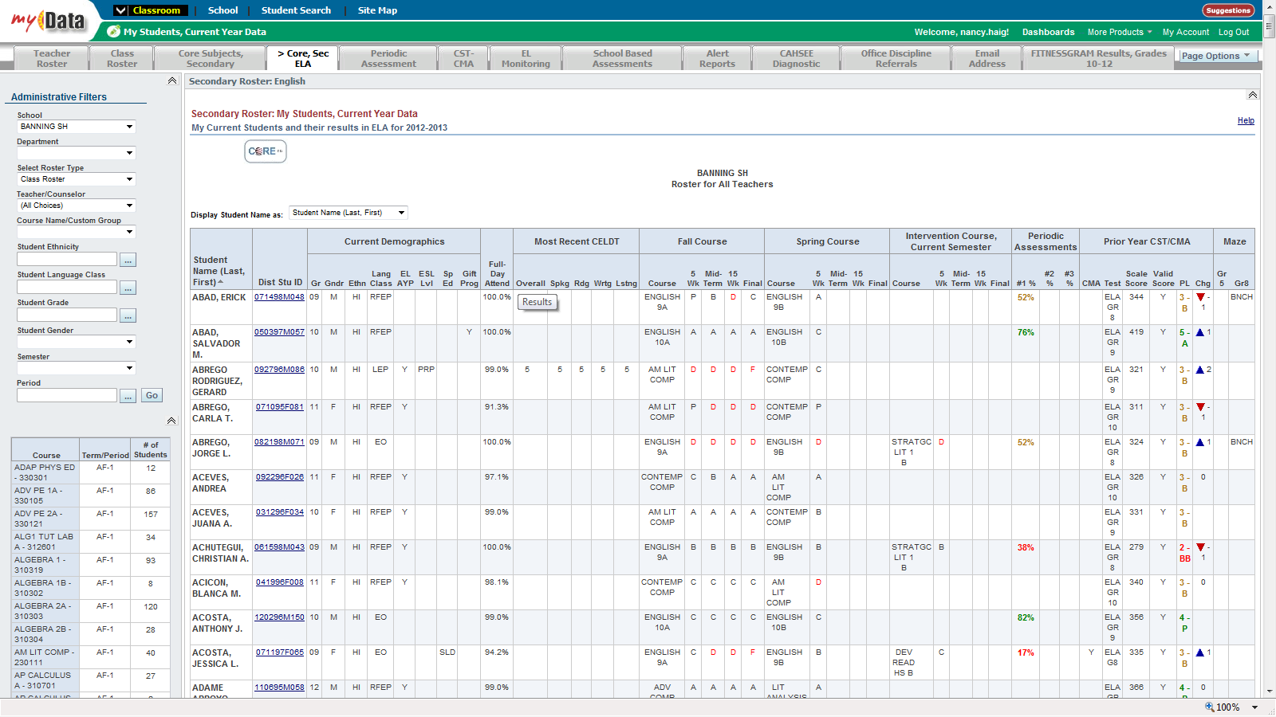
Secondary – English Language Arts
Data: Current Demographics, Attendance, CELDT,
Fall and Spring Course Grades, Periodic Assessments, Prior Year CST/CMA

Slide 68
It’s Your Turn
Use MyData to pull additional LTEL information for your school site.

Slide 69
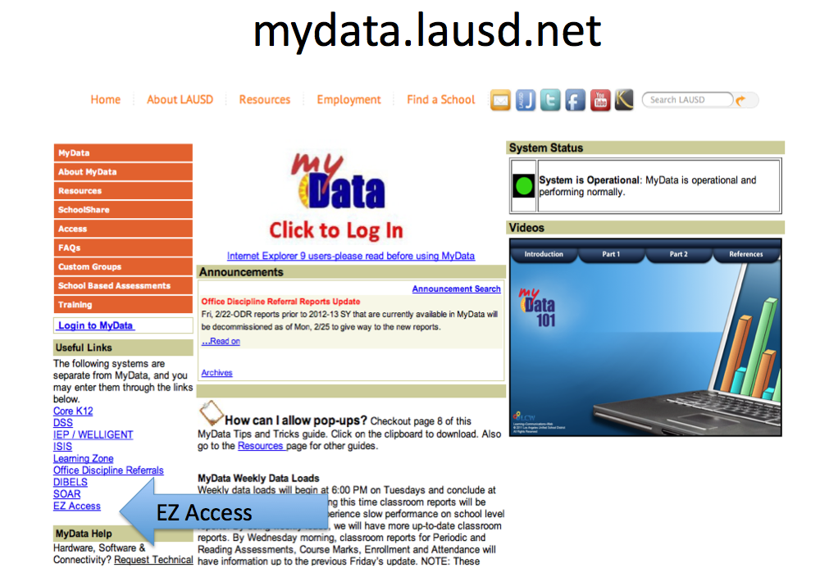

Slide 70

LTEL Students and
Parents Meeting

Slide 71

LTEL Students and Parents Meeting Expectations
At least twice yearly
Meet with every LTEL student and parent(s)
  Individually or in group settings
Topics
  Language status
  Program placement
  Test results
  Goals for attaining reclassification criteria and accelerate academic progress targets

Slide 72
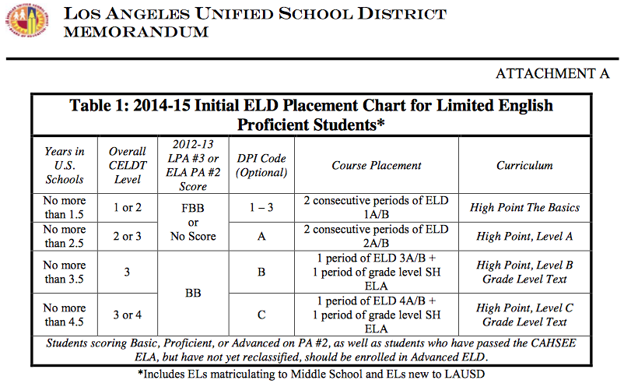
MEM-6046.1
Attachment A

Slide 73
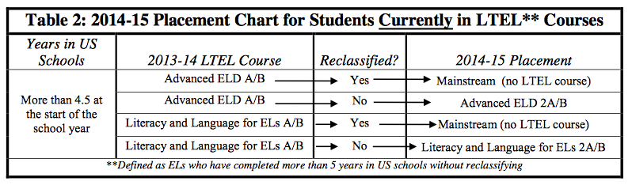
MEM-6046.1
Attachment A

Slide 74
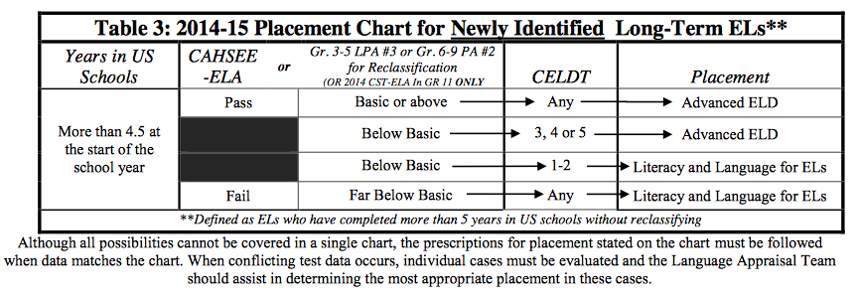
MEM-6046.1
Attachment A

Slide 75
LTEL Meeting Structures
Individual Conferences
Group
Meetings
Large LTEL population
Small or Large LTEL population
Meet individually with students and/or parents together or separately if needed
Meet with students and/or parents together or separately in groups if needed

Slide 76
Using Existing Structures
Individual
Conferences
Group
Meetings
LTEL Designee Team Members:
Counselors, Department Chairs, Teachers, Coordinators, Administrators, Coaches
LTEL Designee Team Members:
Counselors, Department Chairs, Teachers, Coordinators , Administrators, Coaches
-During parent/teacher conferences
-Individual Graduation Plan meeting
-Classroom presentation
-Existing small group parent meetings (i.e. before or after student performances, before or after ELAC, etc.)

Slide 77


LTEL Student-Parent Meetings
In the event that a parent does not attend a meeting, schools should document a minimum of 3 attempts using at least 2 different methods.

Slide 78

Table Talk
What are existing structures at your school site you could optimize to support the LTEL parent/student meetings?
What are some other structures you could put in place to facilitate these meetings?

Slide 79
BUL-6266.0 LTEL Designees’ Roles and Responsibilities

Slide 80
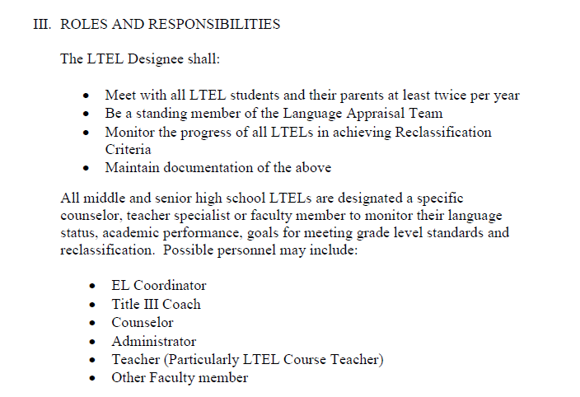
Roles and Responsibilities

Slide 81
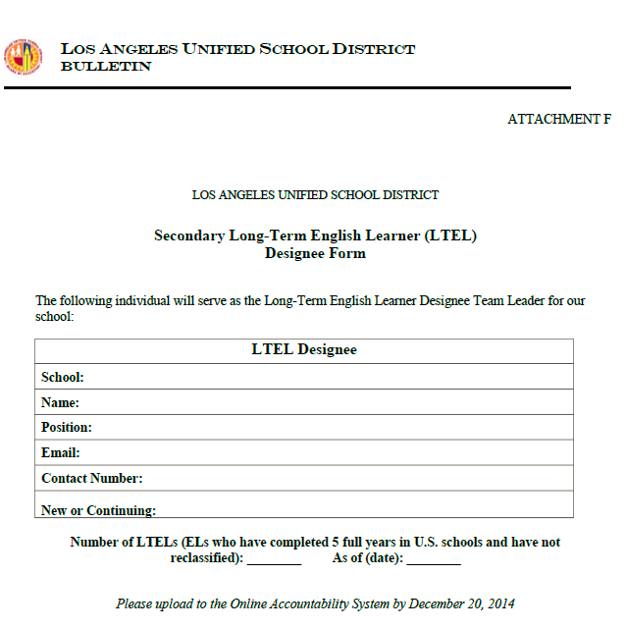
Documentation: LTEL Designee Form

Slide 82
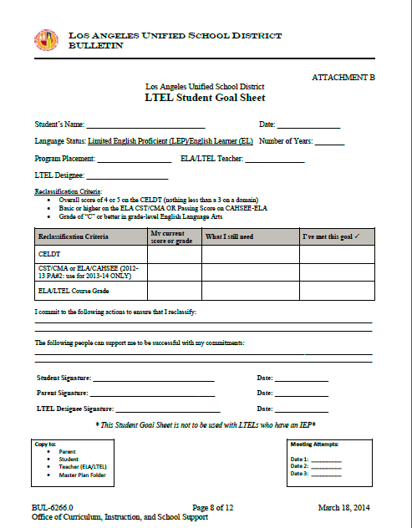
Documentation: LTEL Student Goal Sheet

Slide 83
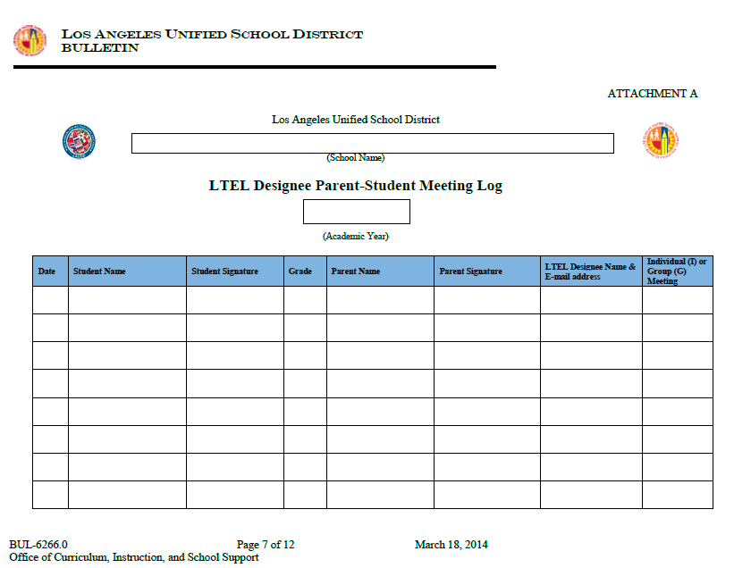
Documentation: Meeting Log

Slide 84
Additional Resource
PPT in English and Spanish to help facilitate a whole group parent meeting
*Coming Soon

Slide 85
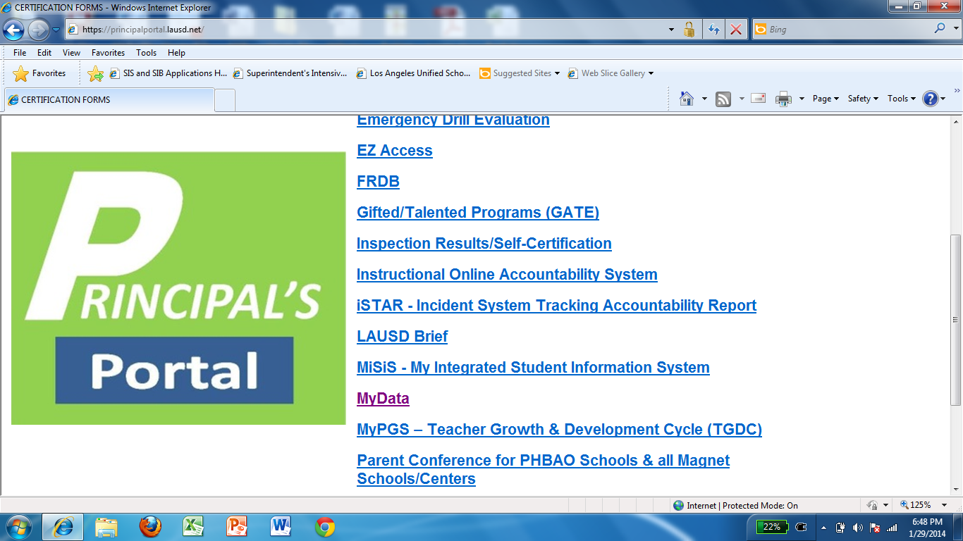
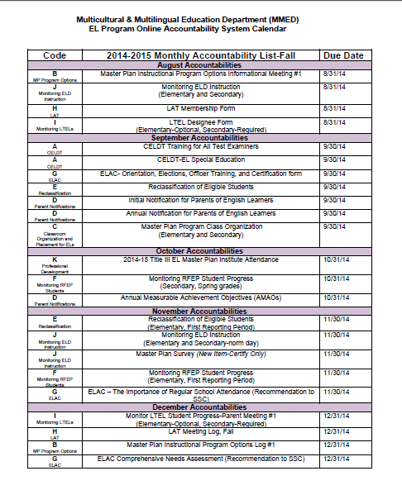
Instructional Online Accountability System
Certification:
  AUG -LTEL Designee Form
  DEC -LTEL Student-Parent Meeting #1
  APR -LTEL Student-Parent Meeting #2
Upload:
  EL Roster identifying all LTEL students*
  Meeting announcement
  3 completed LTEL Student Goal Sheets*
*White out or black out student names

Slide 86

2014-15 Goals
Monitor all LTELs
All LTEL students and their parents will meet twice with the LTEL Designee
  First semester
  Second semester
LTEL Designee must be an active participant of the LAT Meetings

Slide 87
Objectives
To receive an overview of the agreement made with LAUSD and the Office for Civil Rights
To define Long Term English Learners
To understand the roles and responsibilities of the LTEL Designee
To understand how to use the district’s monitoring tools and resources

Slide 88



